Slide 1
Inventory Management System
Project A
Completed: (13/01/2020 - 13/02/2020)
By Jessica Levett
https://github.com/JessicaPorf/OfficialIMS

Slide 2


Who am I?

Slide 3
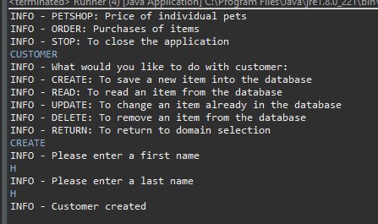
Created functionality for Customer

Slide 4
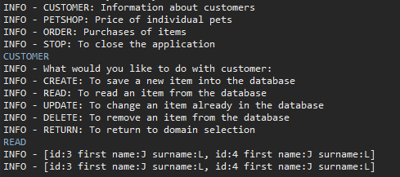
Read functionality for Customer

Slide 5
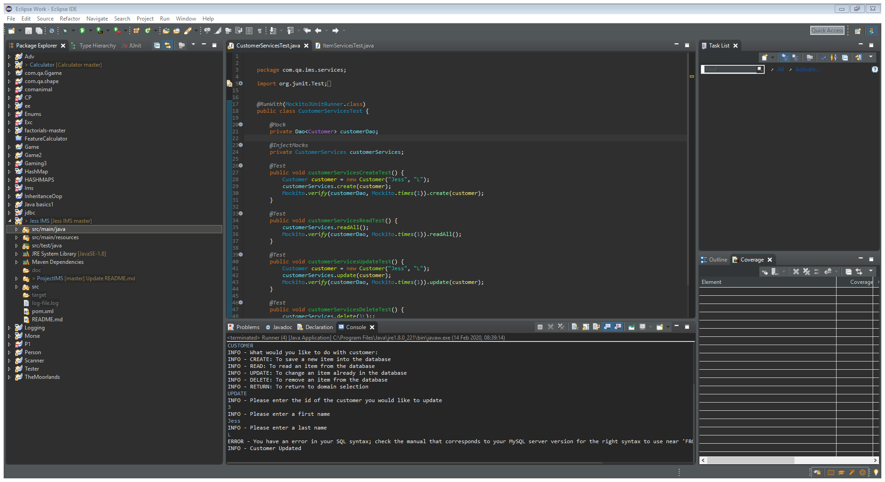
Updated functionality for Customer

Slide 6
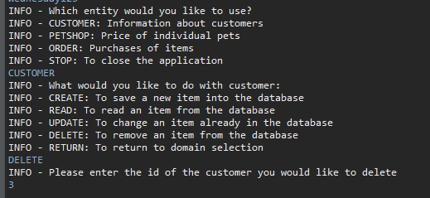
Deleted functionality for Customer

Slide 7
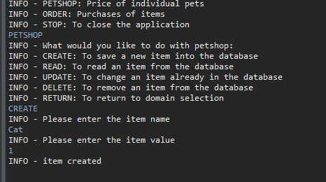
Created functionality for item

Slide 8
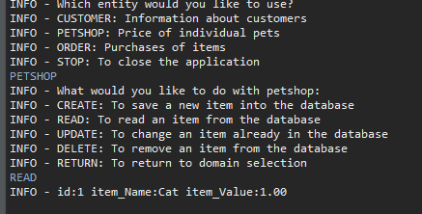
Read functionality for item

Slide 9
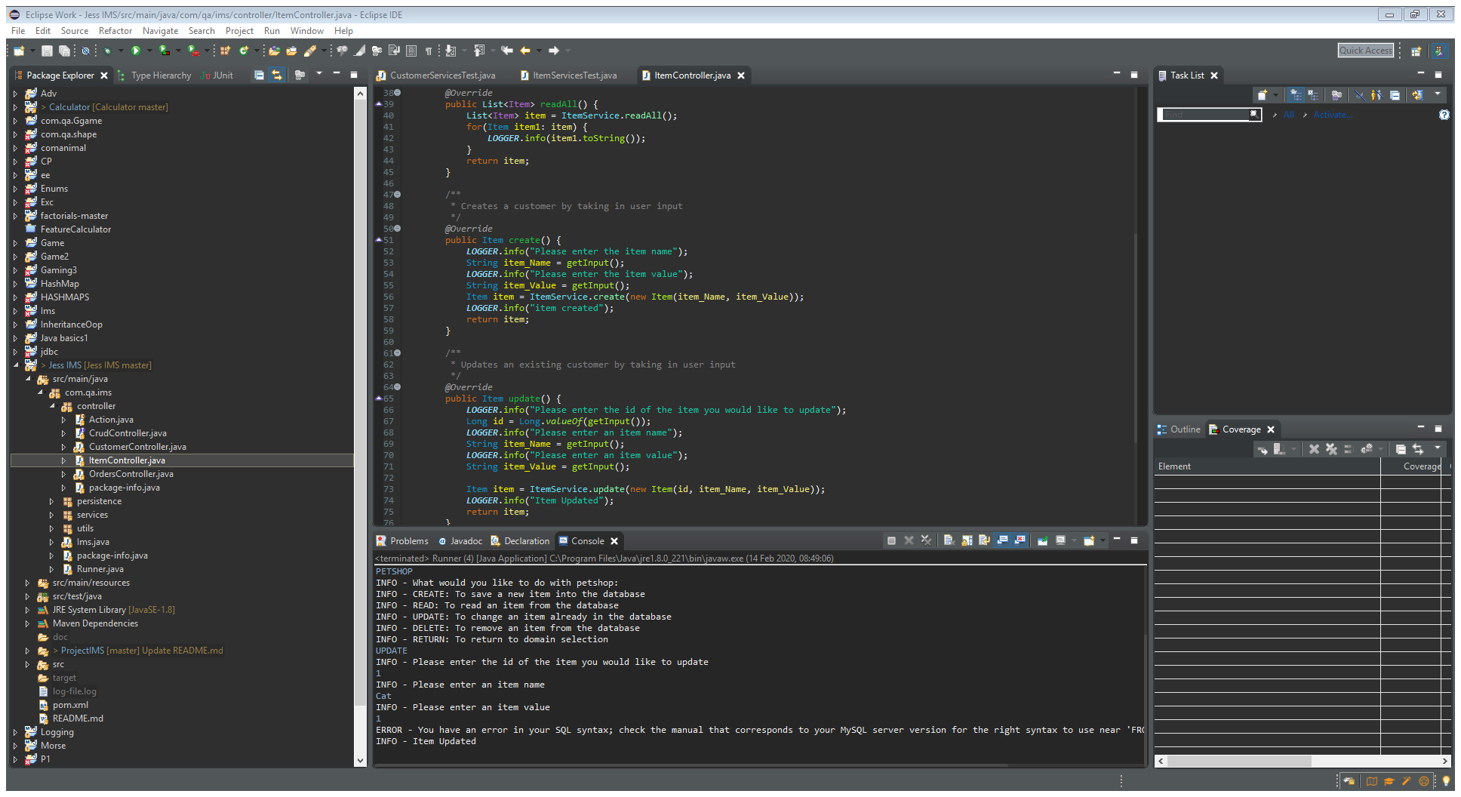
Update functionality for item

Slide 10
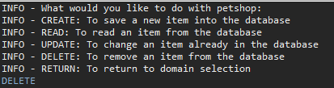
Delete functionality for item

Slide 11
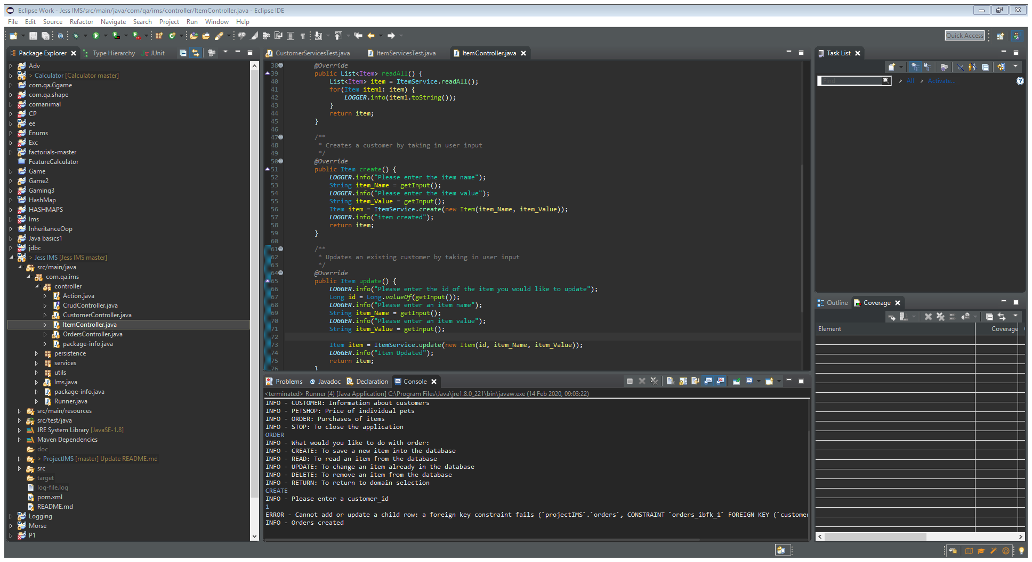
Create functionality for order

Slide 12
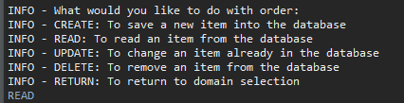
Read functionality for order

Slide 13
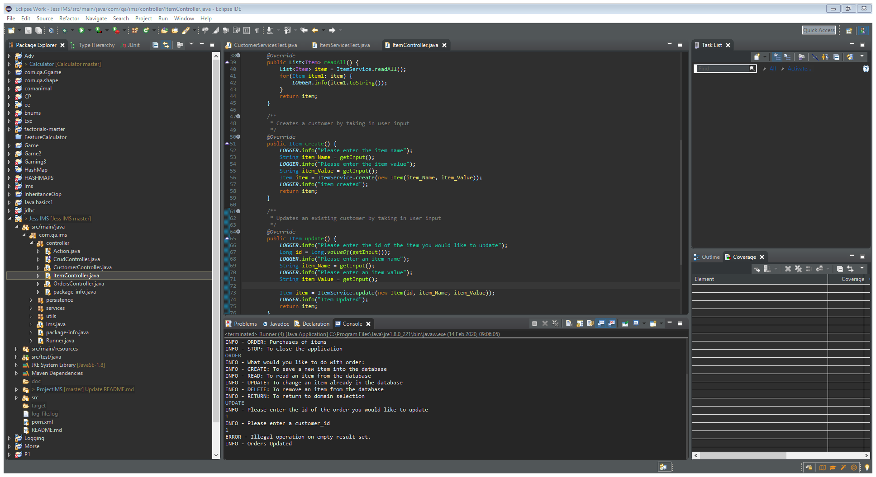
Update functionality for order

Slide 14
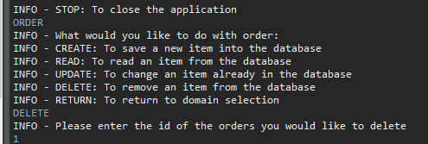
Delete functionality for order

Slide 15
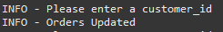
Updated functionality

Slide 16
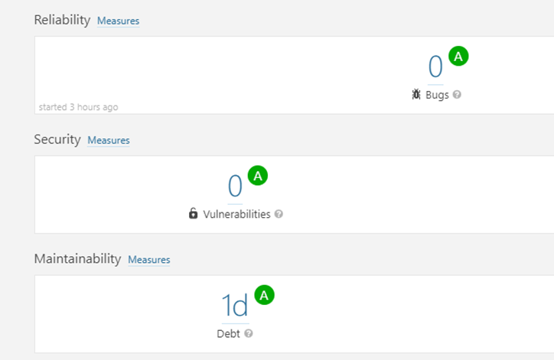
Resolves Issues specified by SonarQube

Slide 17
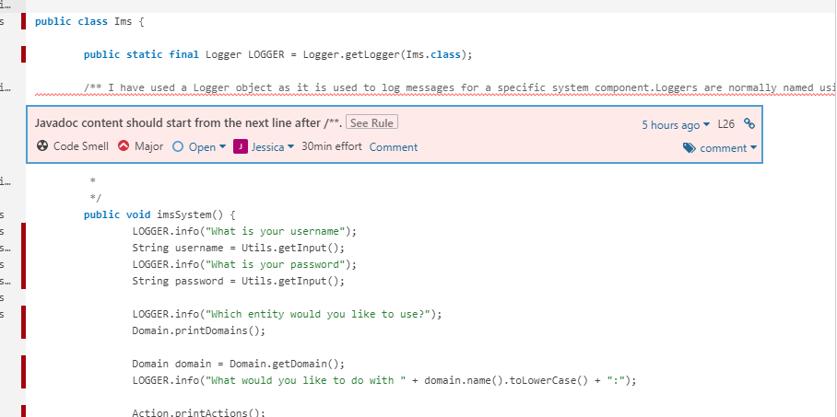
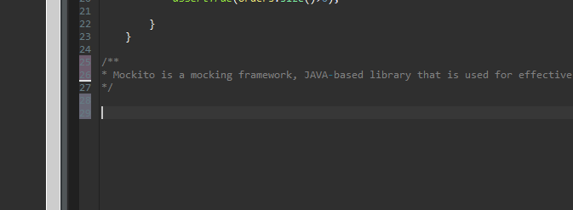
e.g. fixing code smells

Slide 18
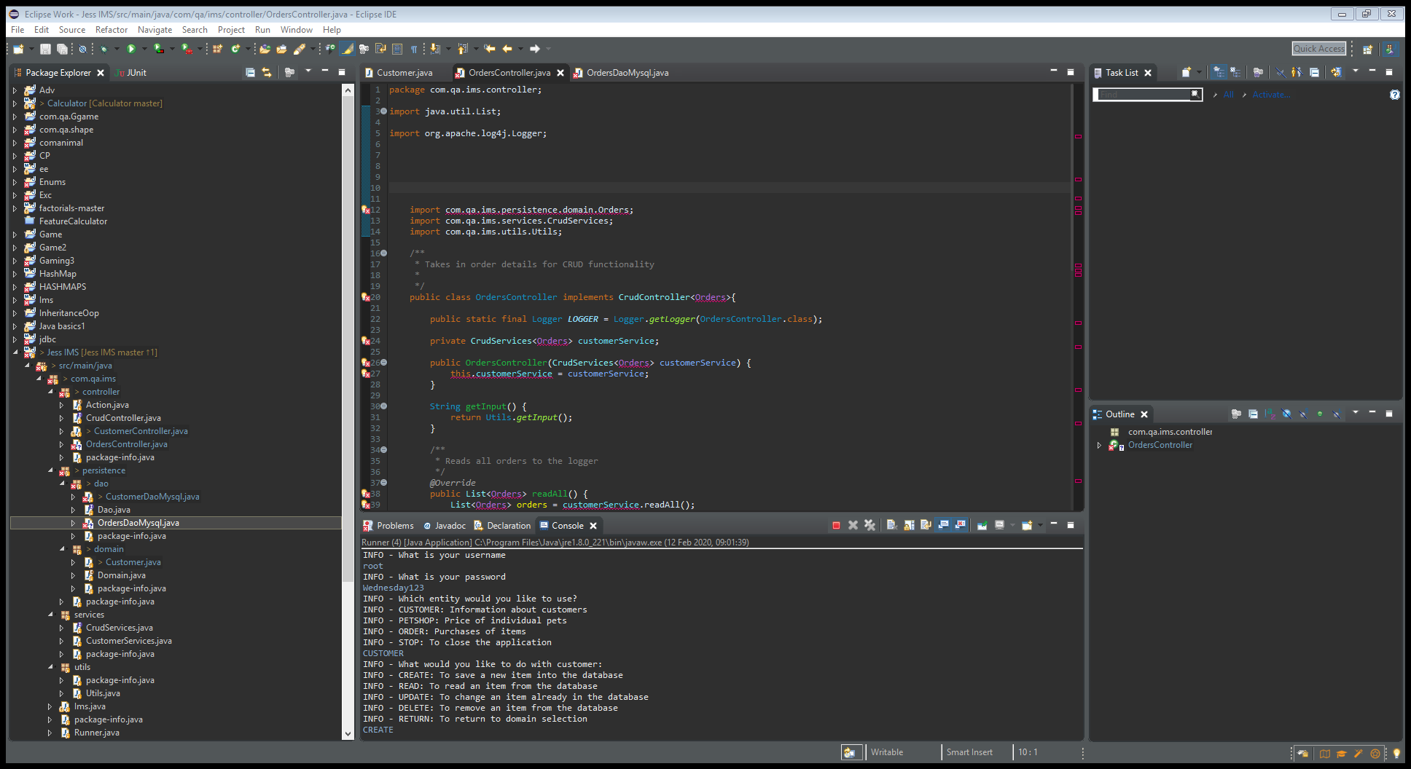
Uses PascalCase for classes and camelCase for methods and variables
Classes were in PascalCase
My methods and variables were in camelCase

Slide 19
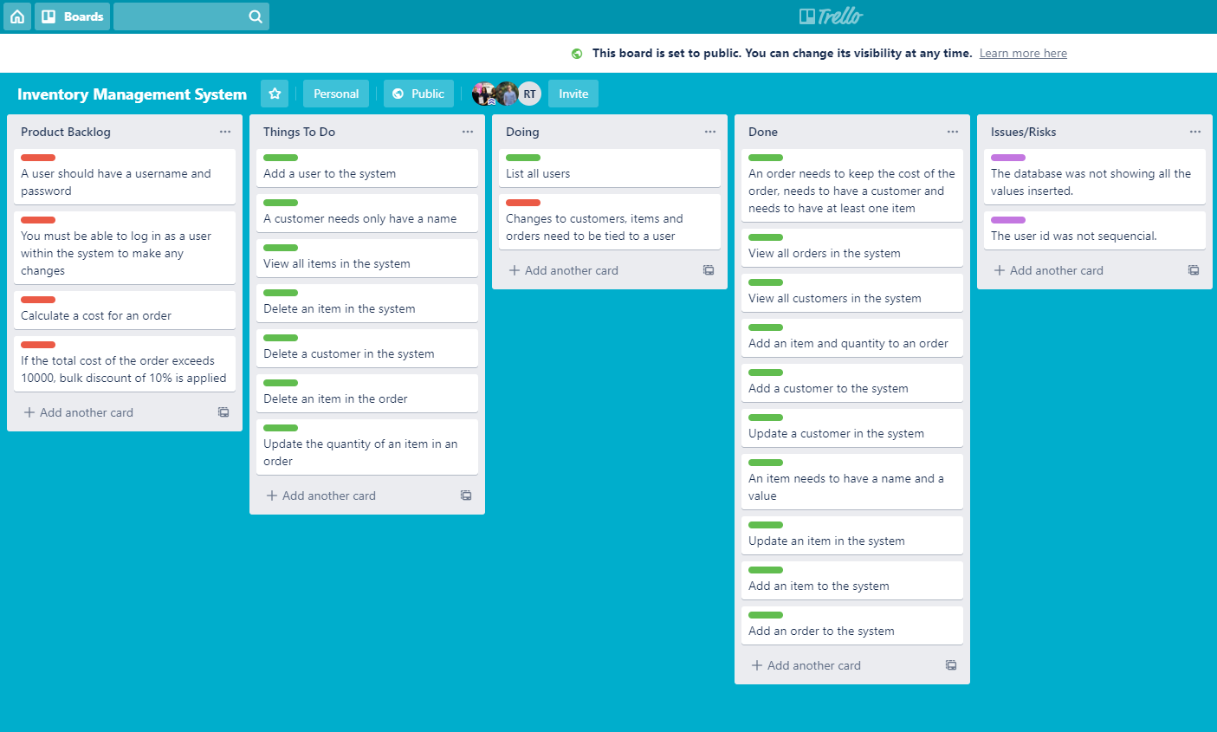
Trello Board Utilised
Link to completed Trello board:
https://trello.com/b/n0IUqnOU/inventory-management-system
Trello board whilst project was in progress.
I had utilized my Kanban board created on ‘Trello’.
I had identified Issues/Risks during the process of creating my project and documented them using my Kanban board.
* I also highlighted the tasks which I found more difficult using the traffic light system, which enabled me to work in a more Agile way.

Slide 20
SonarQube passes code for reliability (bugs), security (vulnerabilities)

Slide 21
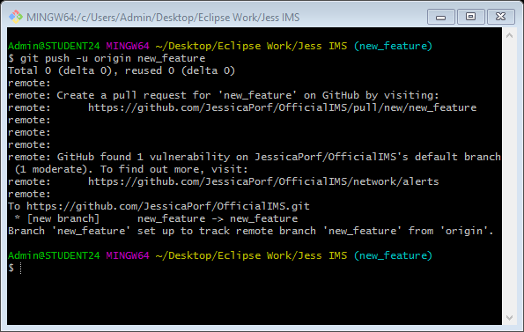
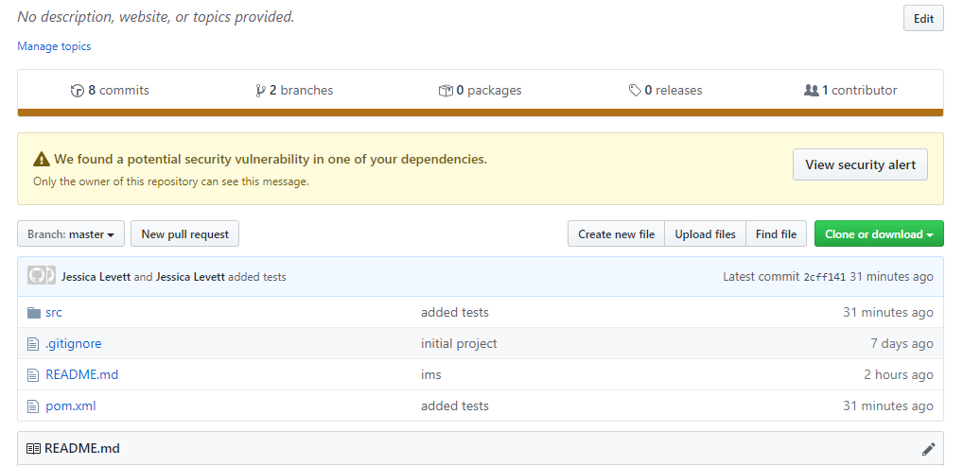
Feature branch model used

Slide 22
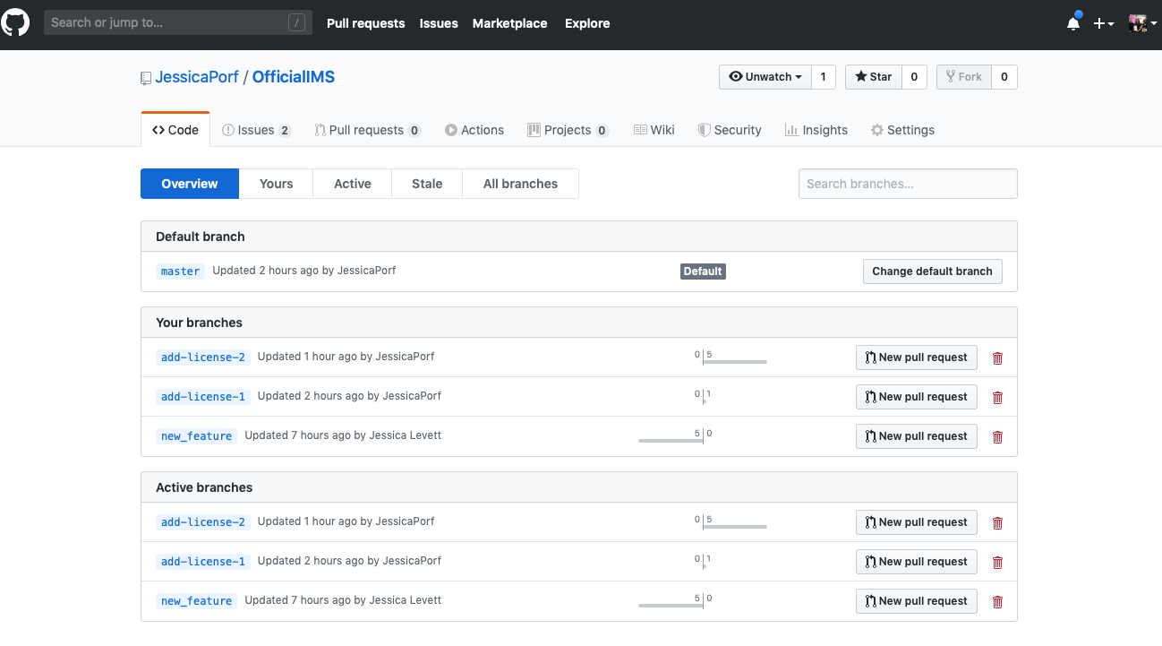

Slide 23
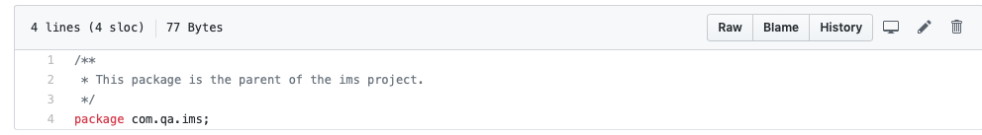
Package documentation with package-info.java

Slide 24
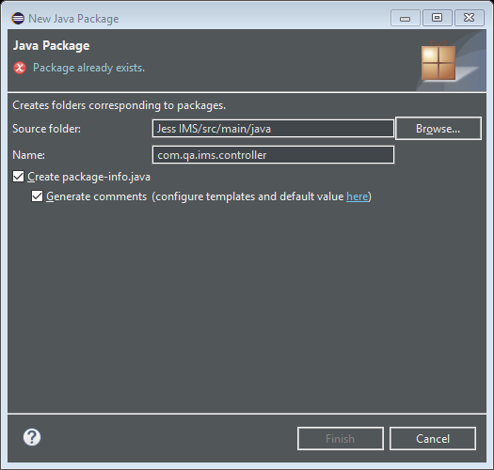

Slide 25
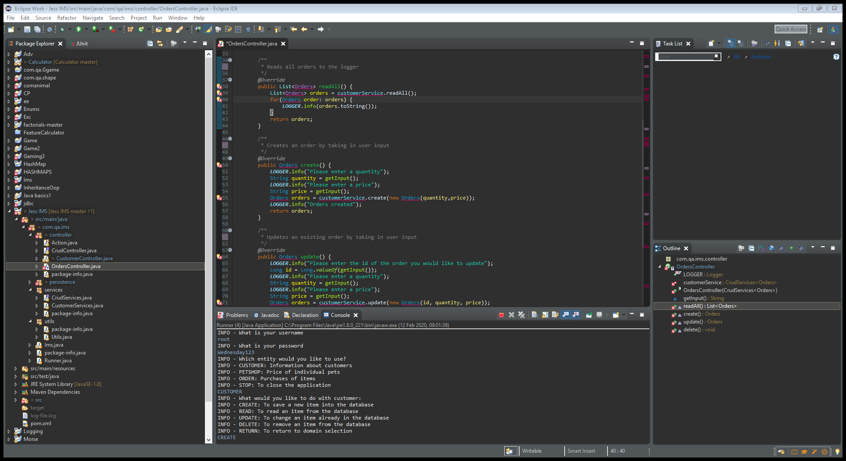
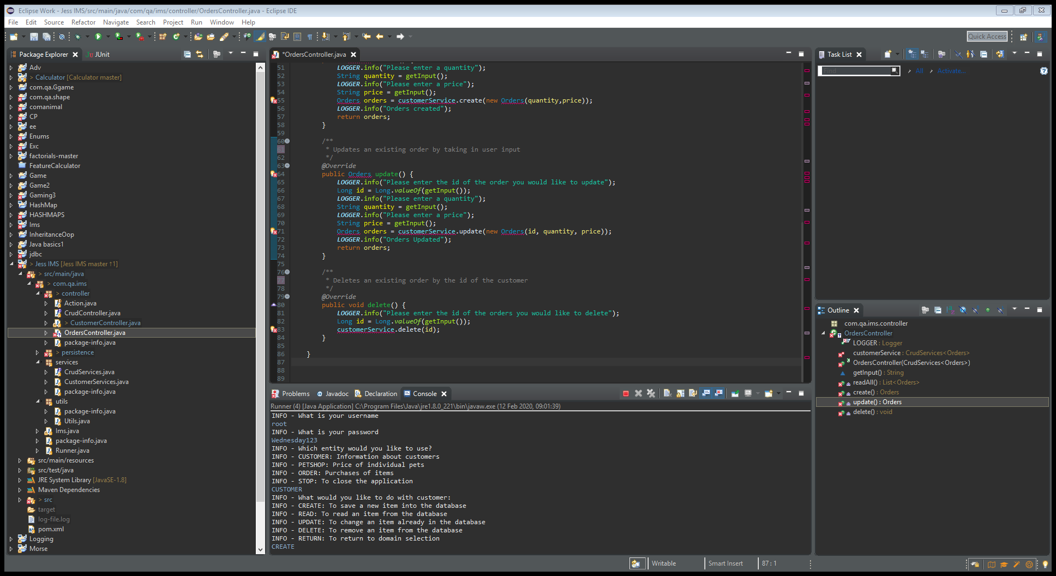
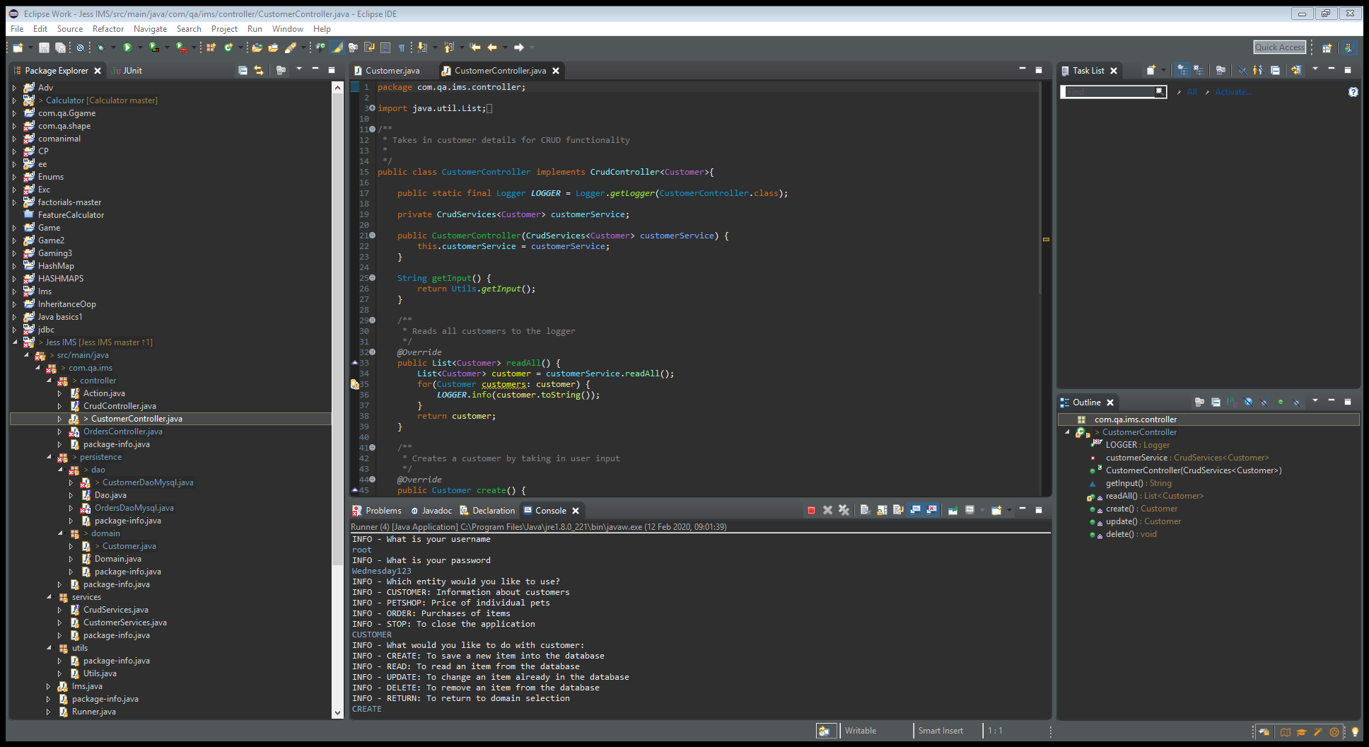
Uses JavaDoc instead of comments
• Each method and class should have documentation explaining its purpose. This will be measured as a 5% document coverage per class
I put comments in JavaDoc by putting them in between
/**
*
*/

Slide 26
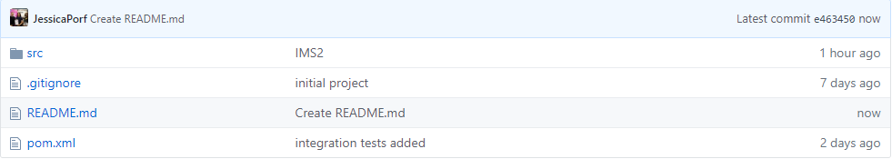
Has a README for the project

Slide 27
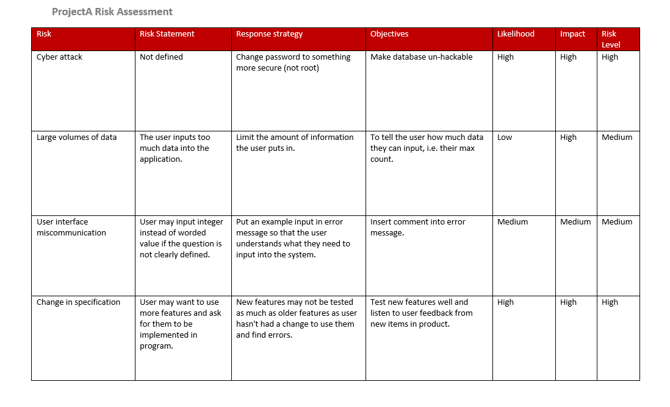
Risk analysis conducting on project

Slide 28
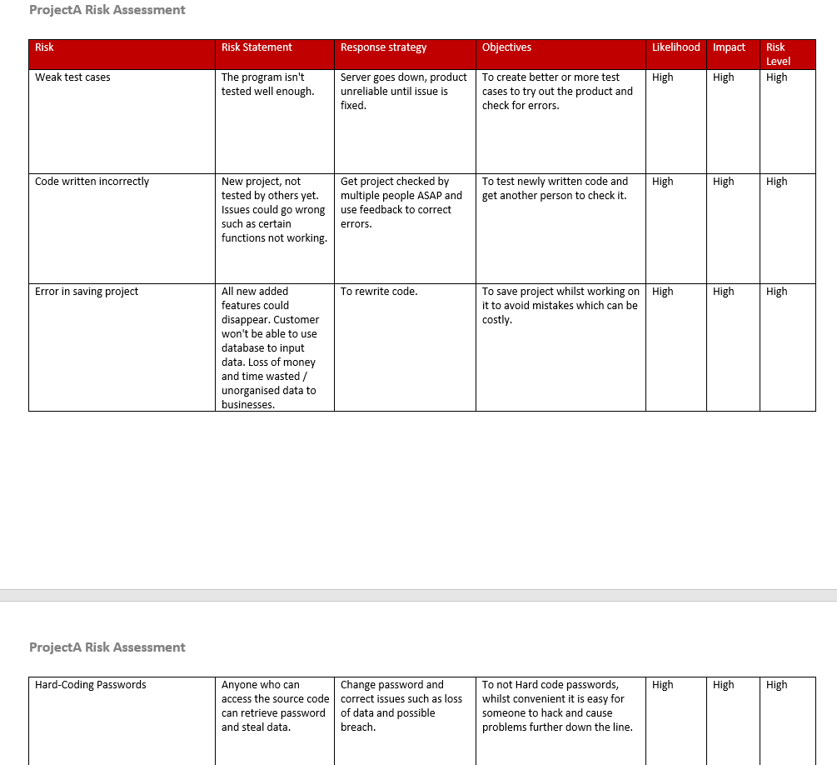

Slide 29
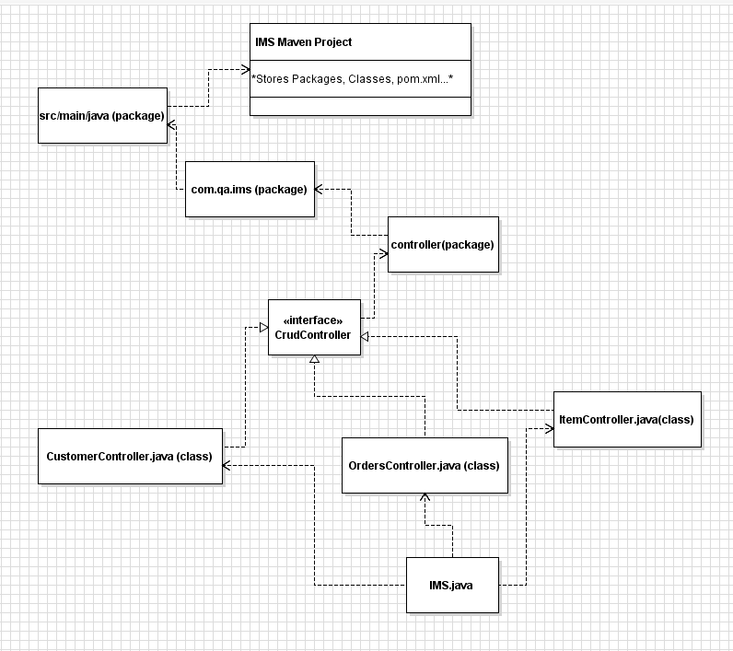
Using UML to design java classes

Slide 30
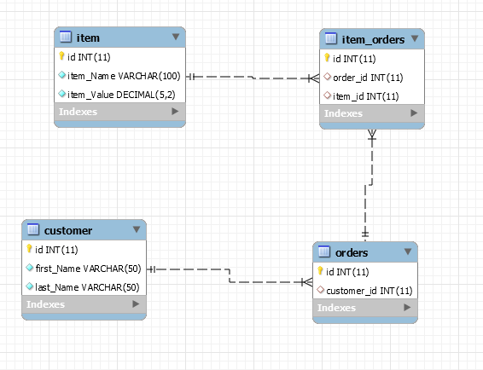
Uses ERD to design database tables

Slide 31
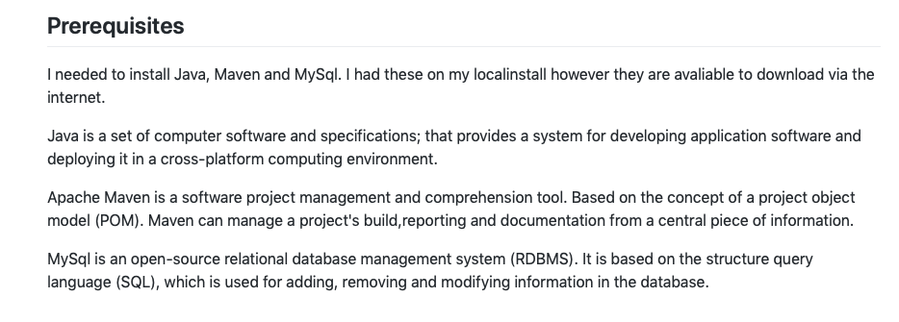
README contains information on prerequisites(items which need to be installed on the machine)

Slide 32
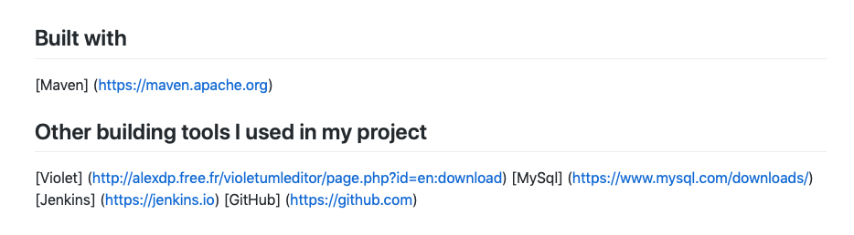
README contains information on what tools will be used to build the project

Slide 33
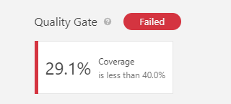
Code analysed by SonarQube
I encountered some issues with SonarQube where I had created more tests but it did not read them, hence the low percentage of test covered.

Slide 34
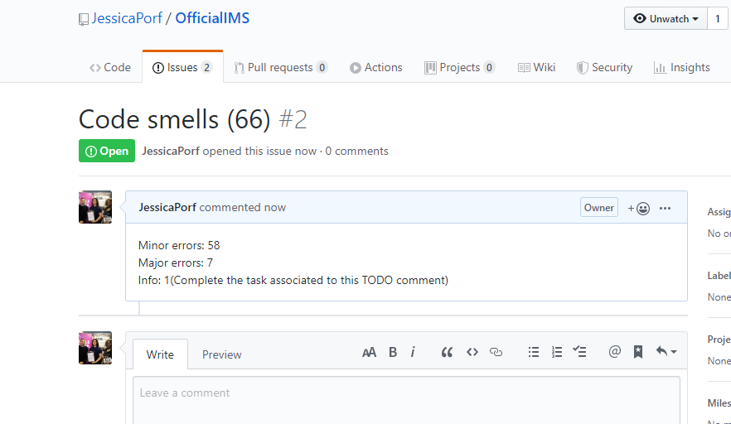
Issues added to remote repository

Slide 35
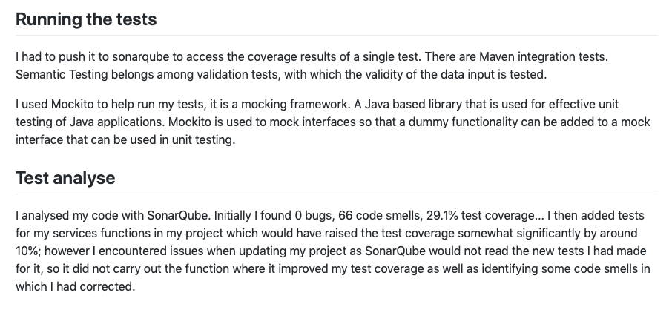
Test analysis included in README

Slide 36
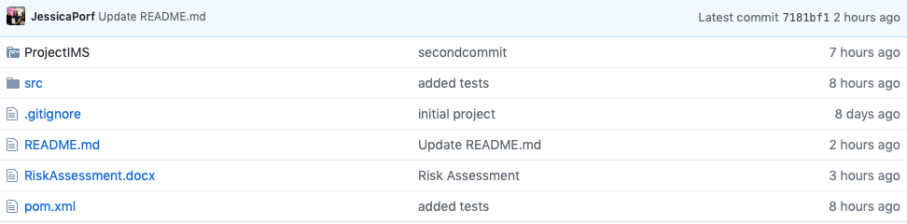
Risk analysis completed for project

Slide 37
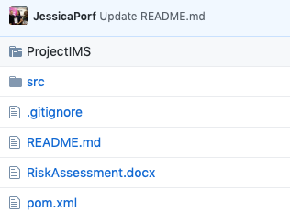
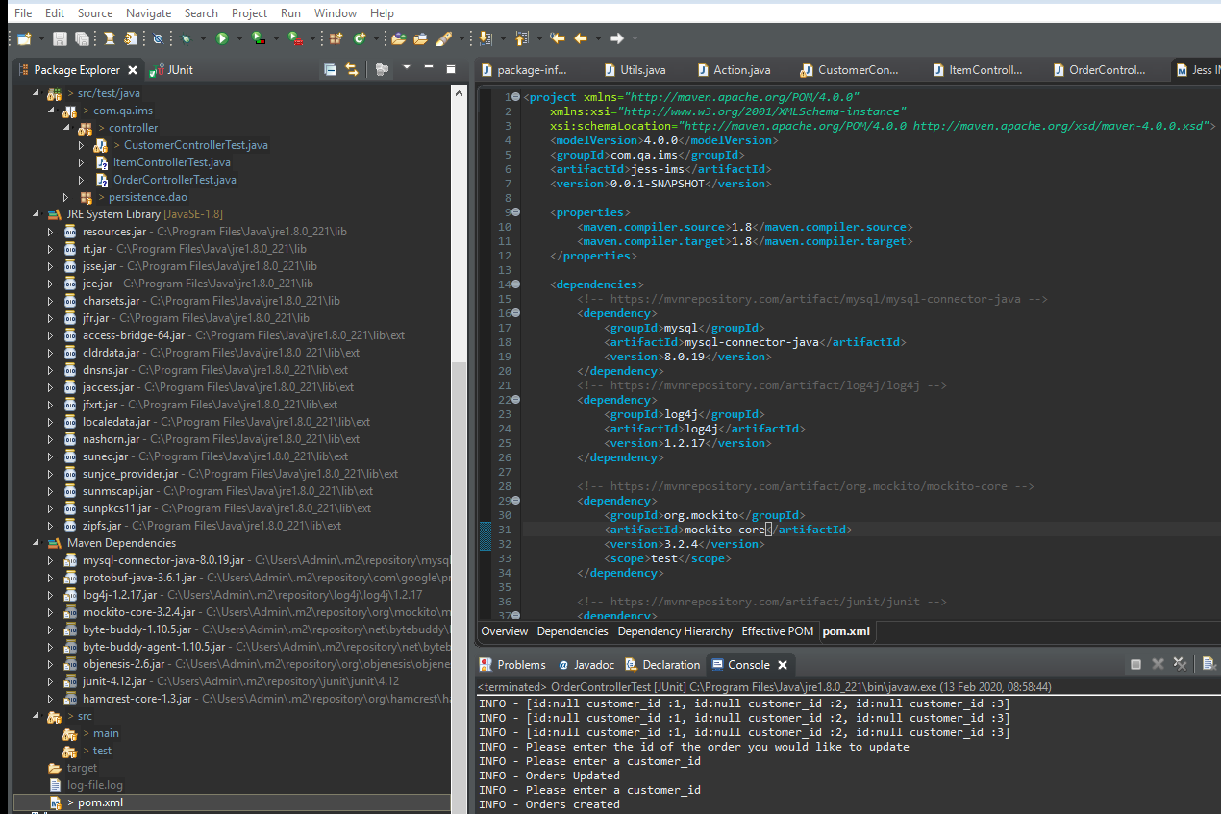
Have a pom.xml in project root and installs maven on remote machine

Slide 38
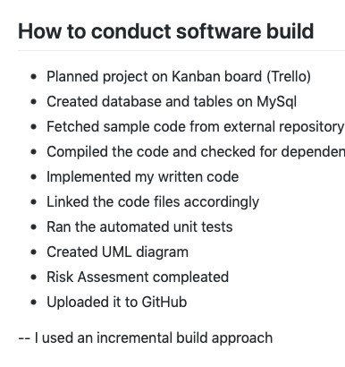
README contains information on how to conduct software build

Slide 39
Issues added to GitHub

Slide 40
Risk assessment submitted to GitHub

Slide 41
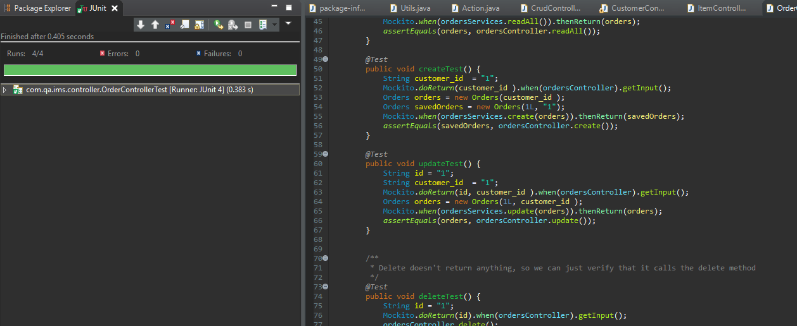
Tests completed on JUnit

Slide 42
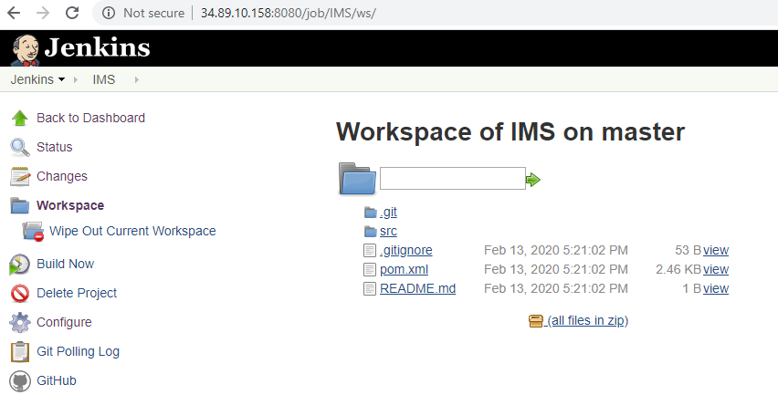
Jenkins used

Slide 43
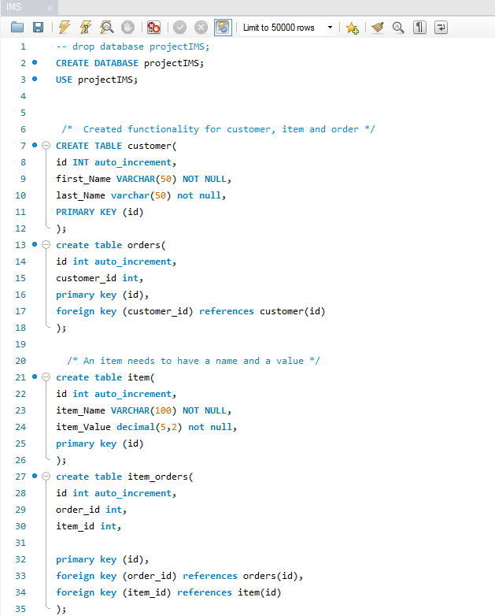
Database and tables created for project
MySql Database

Slide 44
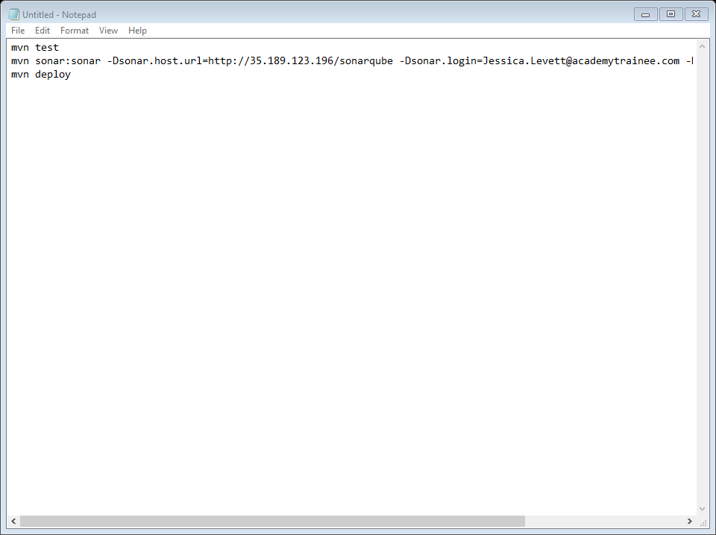
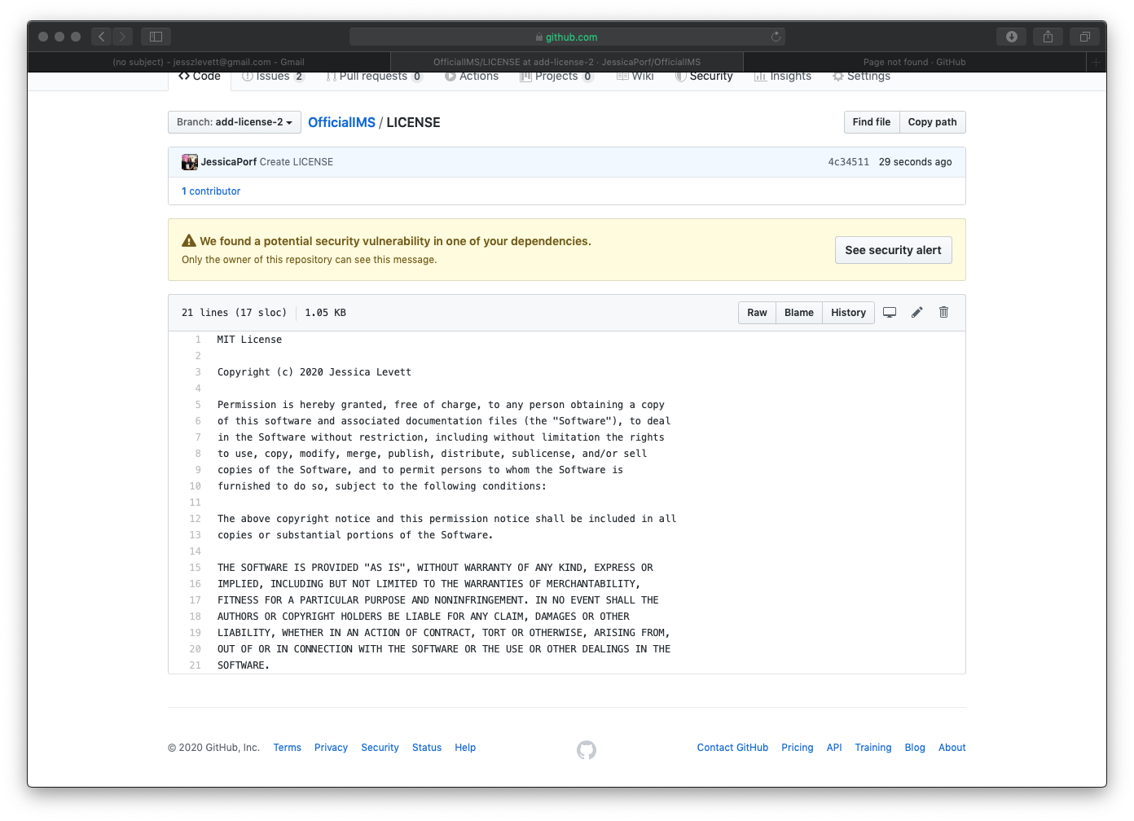
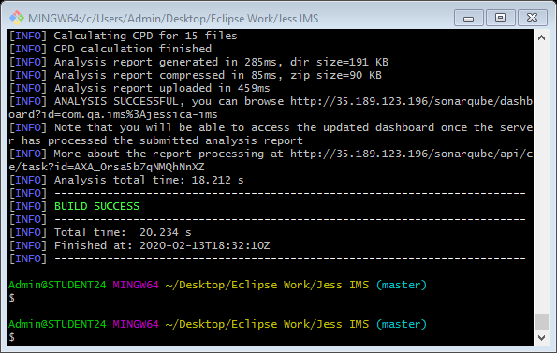
Process of uploading to SonarQube
Official License on my project on GitHub
Process of uploading to Github

Slide 45


